Slide 1

Project name: Breast Tumor detection using GAN
Project guide: Mr. Debkumar Chowdhury
Department of Computer Science
University of Engineering & Management, Kolkata
Tirtharaj Sinha | 3I | 74 | 12019009001134
Anurag Unnikannan | 3J | 09 | 12019009001281
Susmit De | 3J | 72 | 12019009022078
Siddhartha Bose | 3I | 58 | 12019009022034
Arnobrata Ghosh | 3C | 13 | 12019009001398
Devesh Raj | 3C | 21 | 12019009022196

Slide 2
1. Introduction
1.1.1 GAN
Generative Adversarial Network (GAN) is an approach to generative modeling using deep learning methods. It is an unsupervised learning task in ML that automatically discovers and learns patterns in input data in such a way that the model can be used to generate new examples that could have been drawn from the original dataset.
GANs are a clever way of training a generative model by framing the problem as a supervised learning problem with two sub-models: the generator model that we train to generate new examples, and the discriminator model that tries to classify examples as either real (from the domain) or fake (generated). The two models are trained together in a zero-sum game, adversarial, until the discriminator model is fooled about half the time, meaning the generator model is generating plausible examples.

Slide 3
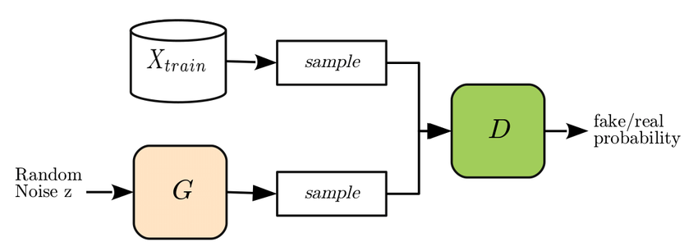
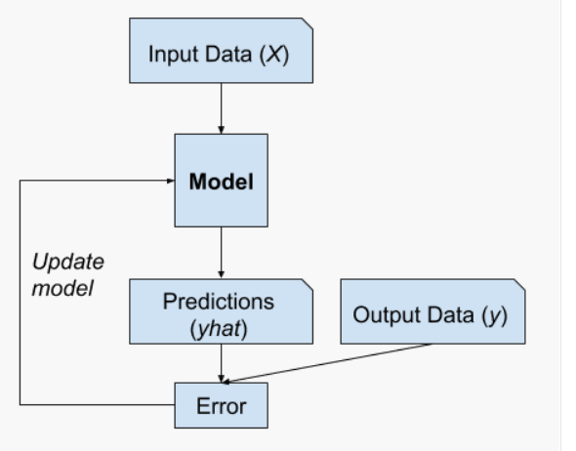
Fig. 0: Simplified diagram of GAN
Fig. 1: Block diagram of training of GAN

Slide 4
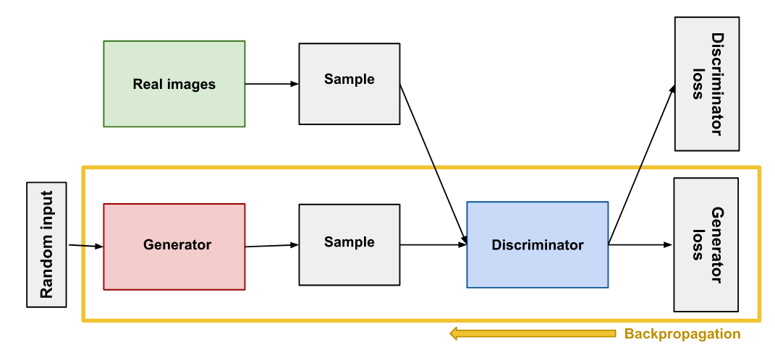
1.1.2 Components of GAN
A generative adversarial network (GAN) has two parts:
The generator learns to generate plausible data. The generated instances become negative training examples for the discriminator.
The discriminator learns to distinguish the generator's fake data from real data. The discriminator penalizes the generator for producing implausible results.
Fig. 2: Modular diagram of GAN

Slide 5
1.2 Types of GAN
Vanilla GAN: It is the simplest type of GAN where generator and discriminator are a simple multi-layered perceptron.
Deep Convolutional GAN (DC GAN): DC GANs comprises of ConvNets and are more stable and generate higher quality images.
Conditional GANs use extra label information to generate better results.
Super Resolution GAN (SR GAN): SR GAN generate a photorealistic high resolution image when given a low resolution image.

Slide 6
1.3 Applications of GAN
Generating new samples for image datasets, which help improves a dataset for prediction by other models
Image to Image Translation: Converting an image clicked on a day to an image that might look like it was clicked on a night.
Face Frontal view generation: Generating front view of human face from side view.
Text to Image Translation: Generating an image based on a description

Slide 7
1.4 Advantages of GAN
Data generated by GAN looks very similar to original data.
GAN goes into in-depth details and can easily interpret into different versions of an object.
By using GAN, we can easily recognize various objects, for example, trees, person, cyclist, cars etc.
GAN is faster than Convolutional Neural Networks (CNN).
It does not require preprocessing.

Slide 8
2. Mathematics behind GAN
2.1 Mathematical and graphical view
2.1.1 The Mathematical formula for the GANs can be represented as…..
V(D,G) = E _{x-pdata(x)}[ log D(x) ] + E _{x-pdata(x)}[ log(1- D(G(z)) ]
where,
G=Generator
D=discriminator
P _{data}(x) = distributor of real data
P (z) = distributor of fake data
x=sample from P _{data}(x)
z=sample from P(z)
D(x) = Discriminator network
G(Z) = Generator network

Slide 9
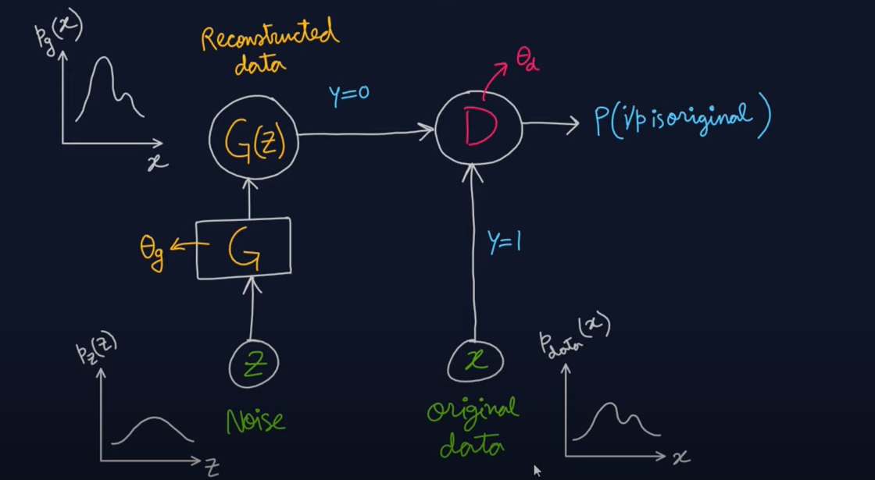
2.2 Visualizing the mathematical data in GAN
The below image is replicating the mathematical steps in visual way.
Fig. 3: Visual data: mathematical steps

Slide 10

2.3 Deriving the value function from Binary cross entropy Function
Detecting the Tumor is a binary classification problem.
Binary cross entropy function:
Z=-$\text{Σ}$y ln(ŷ) + (1-y)ln(1-ŷ)
when y=1, ŷ=D(x) => z=ln[D(x)] -------(I)
when y=0, ŷ=G(x) => z=ln[1-G(x)] ------(II)
Adding, I,II
Z= ln[D(x)] + ln[1-G(x)]
This is the value function For GAN

Slide 11
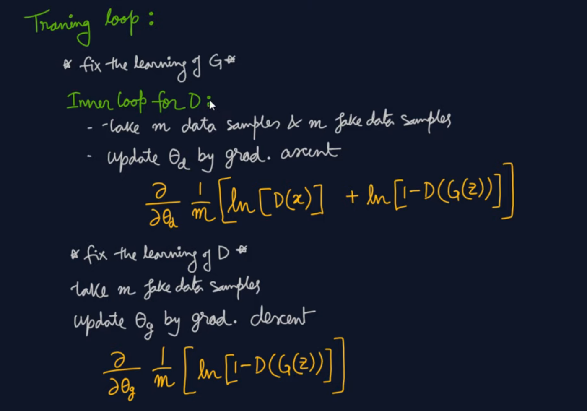
2.4 Steps for Training of GAN from view of Programming

Slide 12
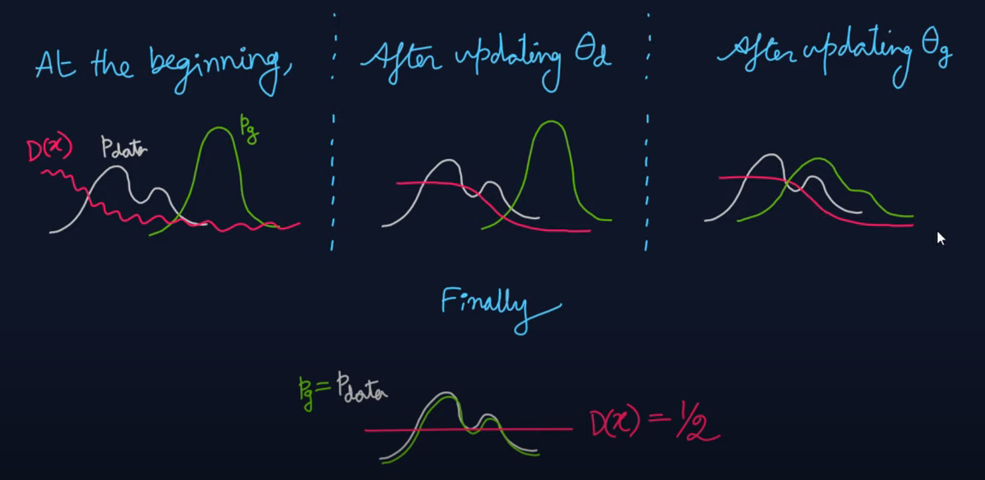
2.5 Training progress of GAN In graphical form of data points
Fig. 4: Graphical data: training progress

Slide 13
3. Bibliography
https://www.wikipedia.com
https://machinelearningmastery.com
https://www.youtube.com
https://towardsdatascience.com/
3.8.6 Documentation (python.org)
[1406.2661] Generative Adversarial Networks (arxiv.org)
https://www.tensorflow.org/tutorials/generative/dcgan

Slide 14
Thank You!

